Slide 1

Christopher Moore CSCI 332 10:50am class Database of StarWars Ships
http://moorect.cscofc.info/index.php

Slide 2
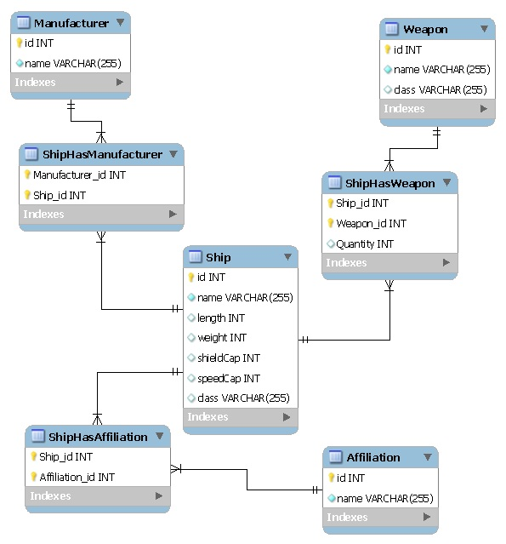
ER Diagram

Slide 3
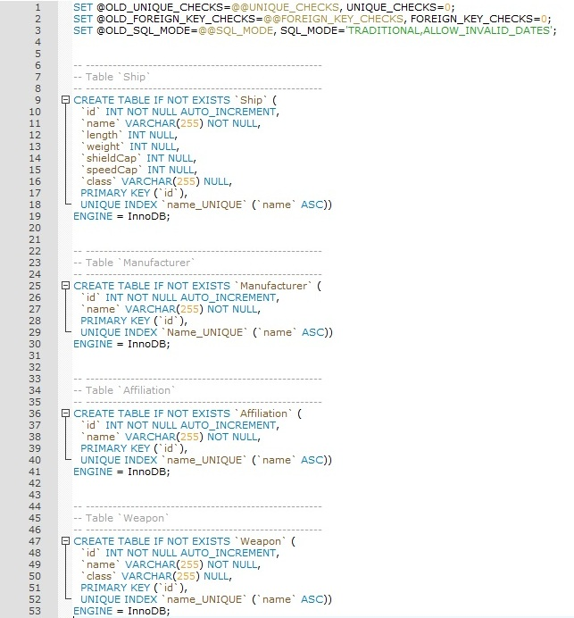
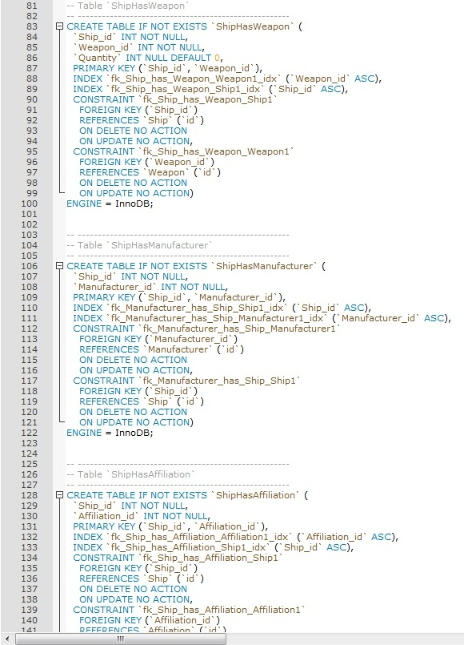
Table DDL

Slide 4
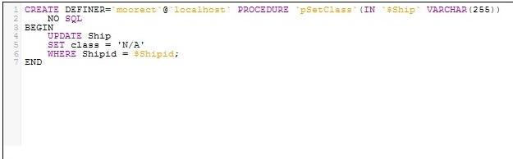
Procedure DDL

Slide 5
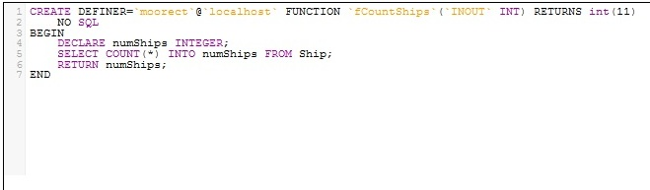
Function DDL

Slide 6
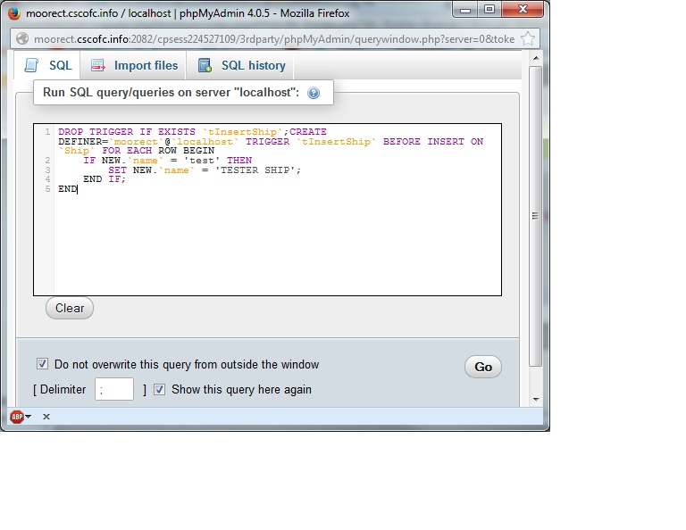
Trigger DDL

Slide 7
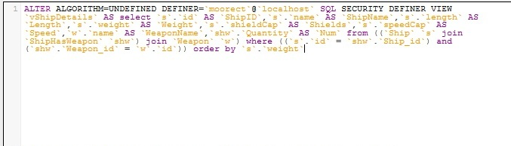
View DDL

Slide 8
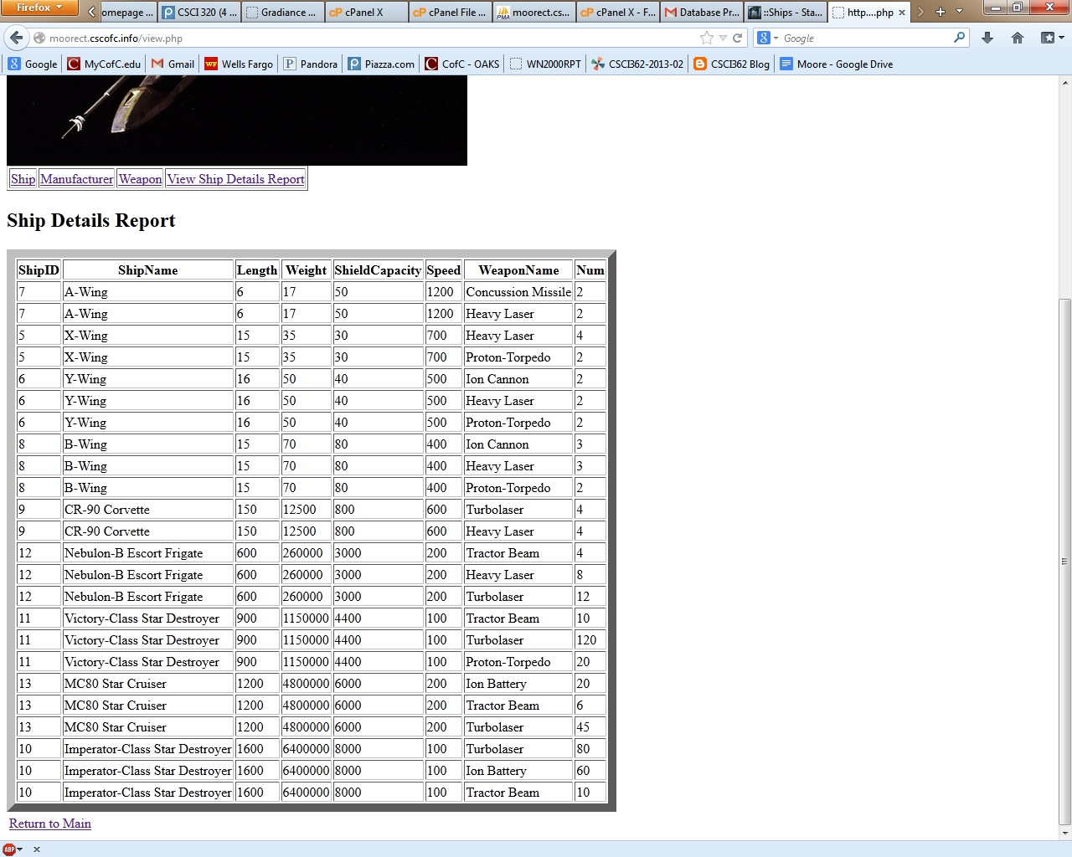
View as a Simple Report

Slide 9
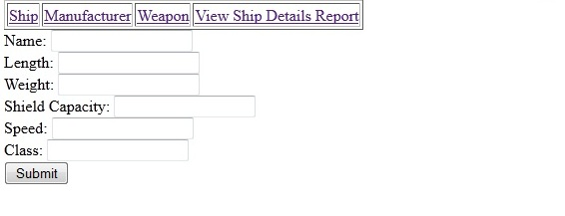
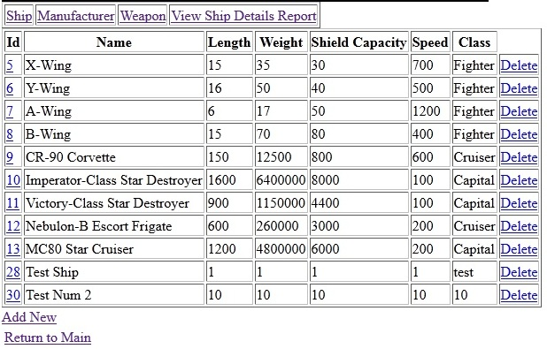
CRUD Operations

Slide 10
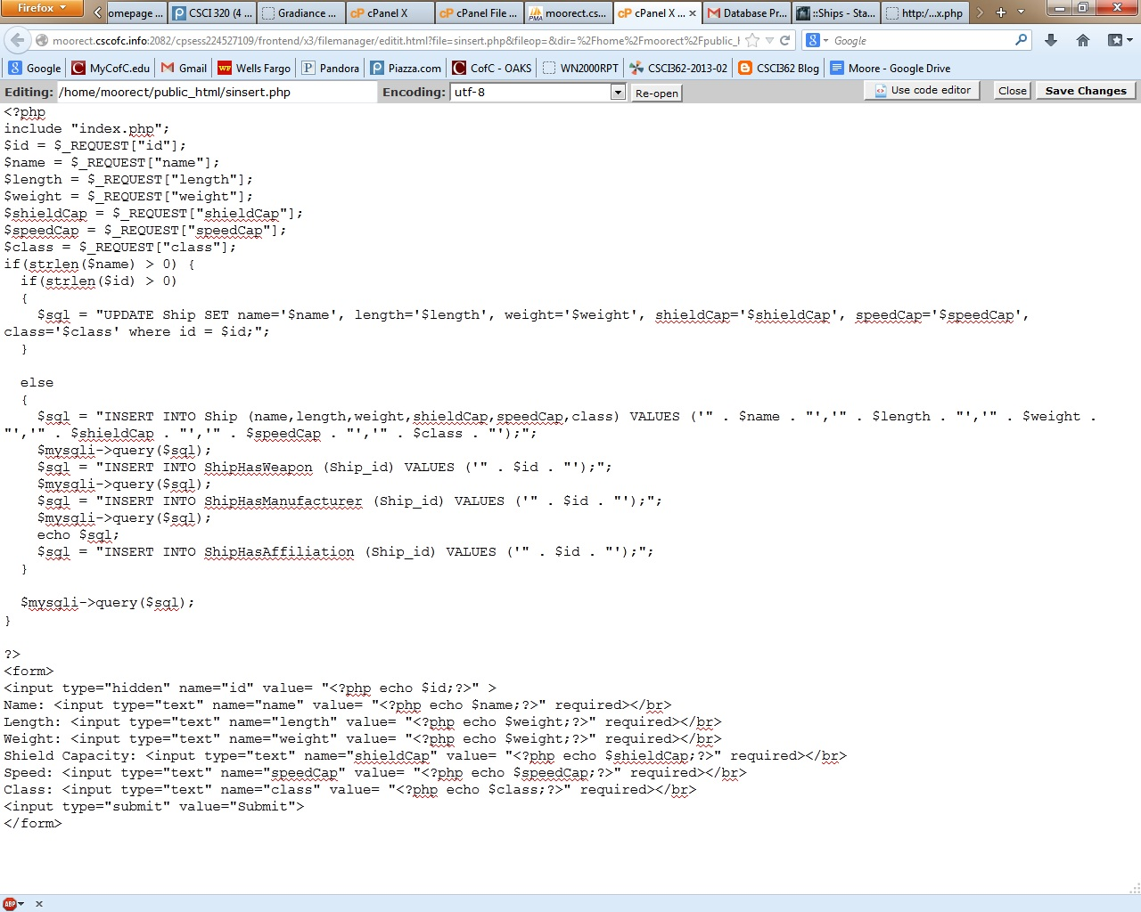
Ship Insert PHP

Slide 11
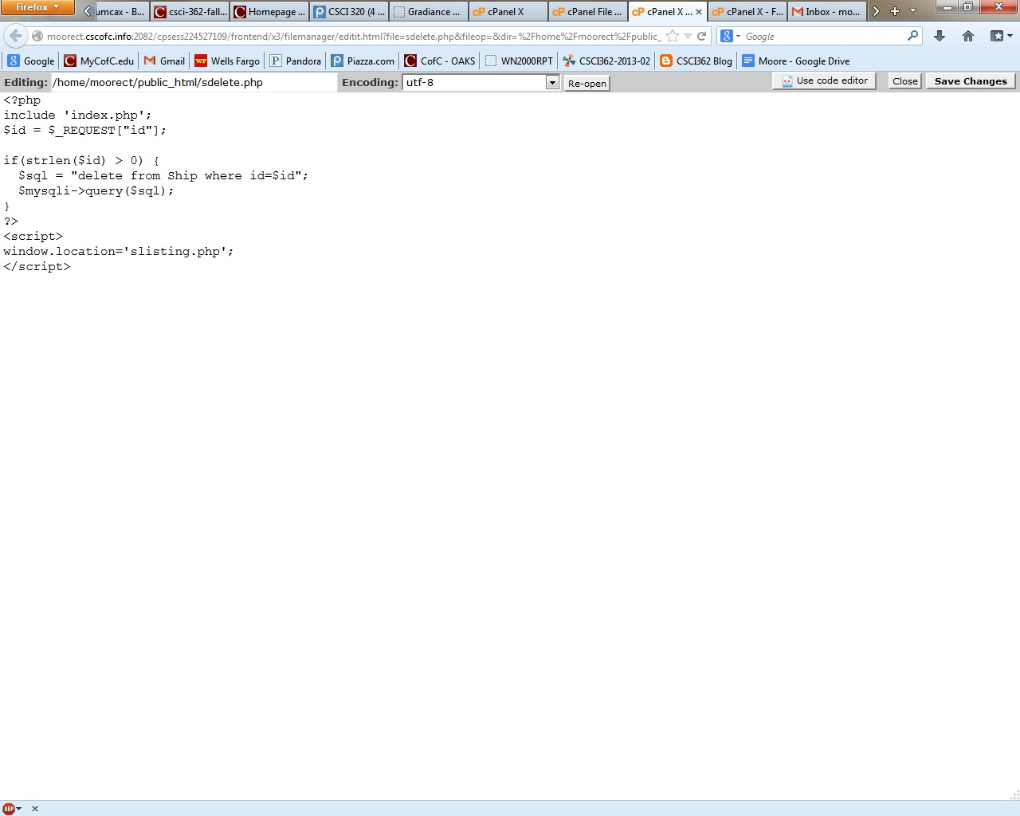
Ship Delete PHP

Slide 12
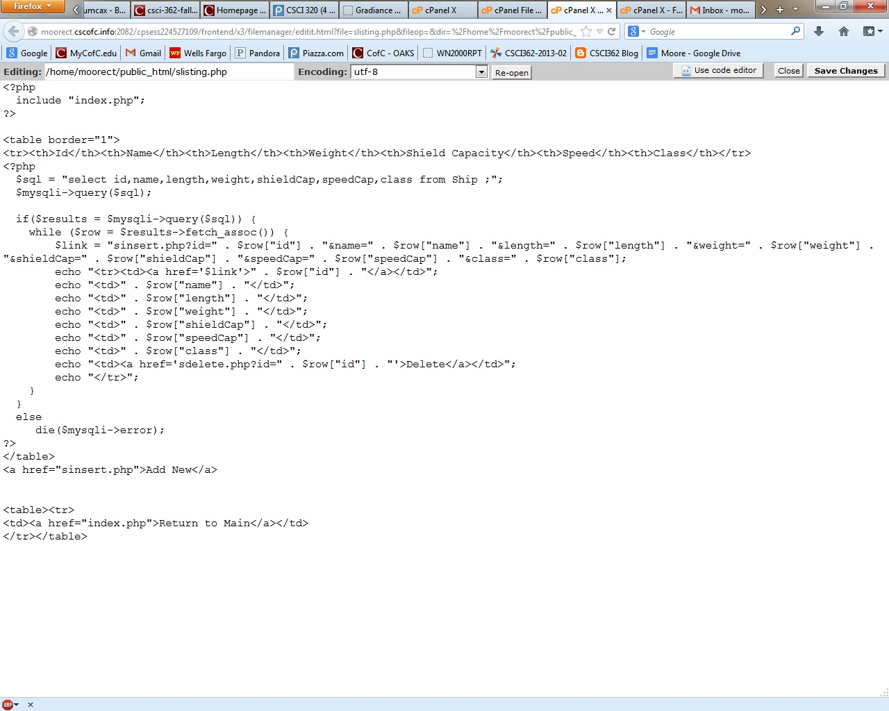
Ship Listing PHP

